Slide 1
HACK NITJ-2020
Problem Statement Title : Court Case Management software
Organization : Dr. BR Ambedkar Institute of Technology
Category : Software
Problem Statement Number : DS159
Domain Bucket : Software – Web App Development
Team Name : Hacking Bad
Team Leader Name : Arsh Goyal
Problem Description
Repository of departmental court cases Design and prepare a court case management software that has facility to record information like adding a case, adding lawyers (have facility select from existing list of lawyers), add invoice for each hearing and for different heads under which lawyers charge the clients. In short the system should provide end to end management of court case from client perspective and should be easy to use.

Slide 2
Features
The web portal will allow the Clients, Lawyers and Judges to register themselves into the system via Email.
Client will have a dashboard where there will be following features :
A Case section where the pending cases and there information like hearing dates, last hearing summary will be there.
Add Court Case Section to add new cases and it’s information and documents can be uploaded.
Choose Lawyers on the basis of their fees, case type expertise and work experience.
Pay Lawyers with Secure Payment Service.
Add Invoice for each hearing.
Case Calendar which will have current, past & upcoming months for hearing/ response dates.
Auto Reminders (Mail & SMS) will be sent to lawyer responsible for the case.
Update Hearing status, winning prospects, outcome etc.
Case Filtering on the basis of Respondent Name, Lawyer Name, Hearing Dates etc.
The Case Section will have the following details :
Each hearing Summary.
Case Number and Hearing dates
Judge Details.
Respondent and Petitioner Details. etc.
Client can Extract and download Case Histories and Documents into a word or pdf file which will help in
reducing the paperwork.

Slide 3
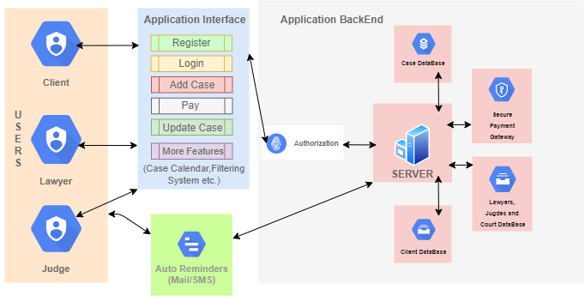
Technology Stack
Use Cases
FrontEnd:
HTML 5/CSS 3
JAVASCRIPT
BOOTSRAP
BackEnd :
Django/Node.JS
Database :
SQL/Mongo DB
Secure Payment Gateway :
Instamojo/ CCAvenue
Dependencies
Database of Lawyers, Courts and Judges
Secure Payment Gateway

